Slide 1
Welcome to Back to School Night!
Presenting…
Amy Buscaglia, 7th Grade Core Teacher

Slide 2
My background…
Prior to teaching, I worked as a writer and editor in the publishing and technology industries for about 15 years.
But I always wanted to be a teacher.
After taking some time off when my daughter was young, I went back to school to earn my teaching credential.
I am thrilled to be teaching 7th grade Core at WCI.

Slide 3
My WCI Website &
Google Classroom
I post my weekly agenda on my WCI teacher web page before the start of school each week.
Google Classroom will be your child’s main area of access for work in English and Social Studies. The English Google Classroom will also include teaching points for reading & writing. This is especially important to know if your child is ever absent. They can also find my agenda for the week in a separate classroom.

Slide 4
To Access my Agenda on the WCI Website….
To access my website, please go to http://www.walnutcreeksd.org/wci/site/default.asp
Select Staff Directory and then my name, “Buscaglia, Amy.”
Look at the left hand column and review all parts of my site.

Slide 5
To Access my Agenda via the Google Classroom
Your child can use my general Google Classroom to access my Agenda with homework and due dates (print using “portrait”).
Go to www.classroom.google.come
Click “+” then have your child “join a class.”
Use code: z3nu5xk to join!

Slide 6
Late Work Policy
Late work will be accepted in accordance with the WCSD “Homework Policy.”
Of note, I have built in extended time for ALL students. Nothing is due the next day.
In general, if late work is turned in, your child will earn 60% of the total grade. Late Projects will earn a letter grade deduction.

Slide 7
Social Studies
Through a guided inquiry process, we will study the social, cultural, and technological changes that occurred in Europe, Africa, and Asia…a VERY long time ago!
We will examine the growing economic interaction among civilizations as well as the exchange of ideas, beliefs, technologies, and commodities.
Conceptual Threads: Agriculture, Religion, Achievements (connections to today), Social Structure

Slide 8
The WCSD adopted a new SS program created by the Teachers’ Curriculum Institute (TCI). There is an online text book and assignments/activities can be found online (highly beneficial if your child is absent).
Social Studies Standards Addressed: Click on the following link and read/review pages 27-32 https://www.cde.ca.gov/be/st/ss/documents/histsocscistnd.pdf

Slide 9
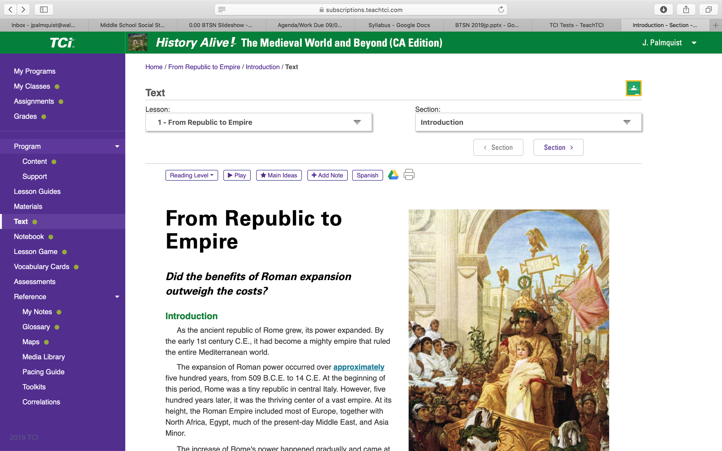

Slide 10
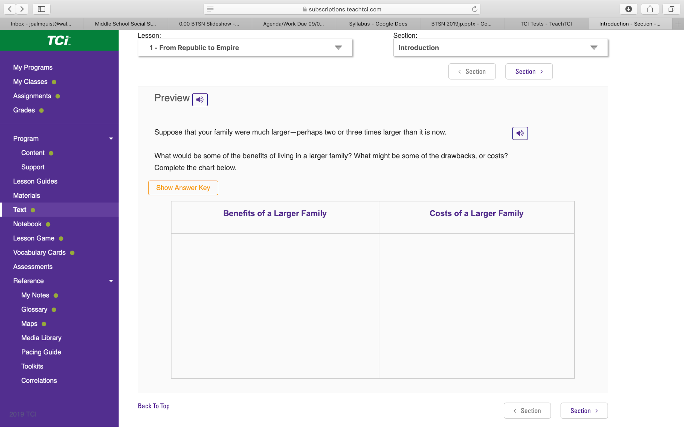

Slide 11
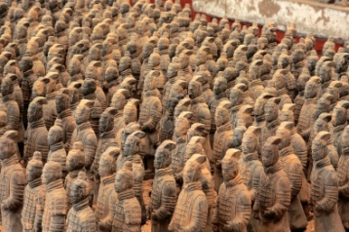
Units of Study:
Rome, The Islamic Empire, Byzantine Empire, West Africa, China, Feudal Japan, Europe – Middle Ages, The Americas, The Renaissance & Reformation, & The Modern Age

Slide 12
Focus Questions:
Overarching Question:
How did distant regions of the world become more interconnected through Medieval and Modern times?
Unit Questions:
How did Europe react to the fall of Rome?
How can religion have a powerful effect on people’s way of life - including culture and government?
How is a civilization’s way of life a product of both people and place?
What factors led to the (economic/political) success of Imperial and Medieval China?
How did Japan’s island location enable it to develop its own unique culture?
What factors led to cultural shifts in Europe? (i.e. Renaissance and Reformation)
What changes in thought led to the Modern Age?

Slide 13
Japan Day & Byzantine Bazaar
We’ll need volunteers!
Japan Day: Tuesday, March 10th (Training night, Tuesday, March 3rd, 7-8:00 PM)
Byzantine Bazaar: Wednesday, May 27th

Slide 14
English
Core 7 teaches English (reading & writing) in a workshop methodology (goes hand-in-hand with Common Core).
It’s all about strategies, modeling, and conferring!
Every child can be a writer!

Slide 15
Reading Workshop
Reading is taught through a series of mini-lessons, student practice, conferring, read aloud, and discussions.
Sustained independent reading will be a focus this year. Students need to, read, read, read!

Slide 16
Reading Workshop
Units Covered:
Informative (RW & WW both included) – Quarter 1
Non Fiction – Quarter 2
Investigating Characterization/Realistic Fiction - Quarter 3
Science Fiction - Quarter 4
Here is a link to an overview of all middle school RW units.

Slide 17
Stories and Books We Will Read
Informative Unit (Writing about Reading):
Mentor Text: “The Stolen Party” Liliana Heker
Students: CHOICE - read a book of their choice (one they love or think they will love)
Non-Fiction Unit:
Mentor Text: “Fast Food Nation” by Eric Schlosser
Students: Reading Groups choice
“Blast Back!: The Salem Witch Trials”
“Vlad the Impaler: The Real Count Dracula”
“Fatal Fever: Tracking Down Typhoid Mary”
“Dark Game - True Stories”
“Imprisoned”
“Bomb”
The Nazi Hunters: How a Team of Spies and Survivors Captured the World’s Most Notorious Nazi
“The Boys Who Challenged Hitler”
Investigating Characterization (students will also be reading a partner selected Realistic Fiction Novel from a collection of authors who have also written short-stories)
“The Outsiders” by S.E. Hinton
Science Fiction
“The Monsters Are Due on Maple Street” by Rod Serling
“Dark They Were, and Golden-Eyed” by Ray Bradbury

Slide 18
Writing Workshop
Writing is taught through a series of mini-lessons, student practice, and conferring.
Units Covered:
Informative (writing about reading) – Quarter 1
Argument – Quarter 2/3, in conjunction with the Historical Fiction Reading Unit
Realistic Fiction/Narrative – Quarter ¾ in conjunction with a Realistic Fiction Reading Unit.
Students will also write several on-demand pieces throughout the school year, in English and Social Studies.

Slide 19
Homework
Homework is limited to reading, writing, and some SS work.
A lot of work, if not most, is completed in class. Any classwork not completed in class, becomes that student’s homework.
Please feel free to email me to find out how your child is doing in regard to turning in their homework – they still need your help!

Slide 20
Communication
abuscaglia@walnutcreeksd.org – This is generally the best way to contact me.
Telephone # 944-6840, x-8205
My prep period is 3rd period.
I will periodically send out communication via emails. But please remember that your child has access to three Google Classrooms that are updated daily/weekly.

Slide 21
Questions?

Slide 22
Thank you for coming!
I look forward to getting to know you and your child! Please never hesitate to email me with any questions or concerns.
Have a great evening!

